Slide 1



Tries
The word "Trie" is an excerpt from the word "retrieval".
Trie is a sorted tree-based data-structure that stores the set of strings
Definition: A tree-like data structure used for storing a dynamic set of strings.
The keys are usually sequences such as words or IP addresses.
Each node in the Trie represents a single character, and paths from the root to a node form a string.

Slide 2
Properties of the Tries for a set of the string
The root node of the trie always represents the null node.
Each child of node is sorted alphabetically.
Each node can have a maximum of 26 children (A to Z).
Each node (except the root) can store one letter of the alphabet.

Slide 3
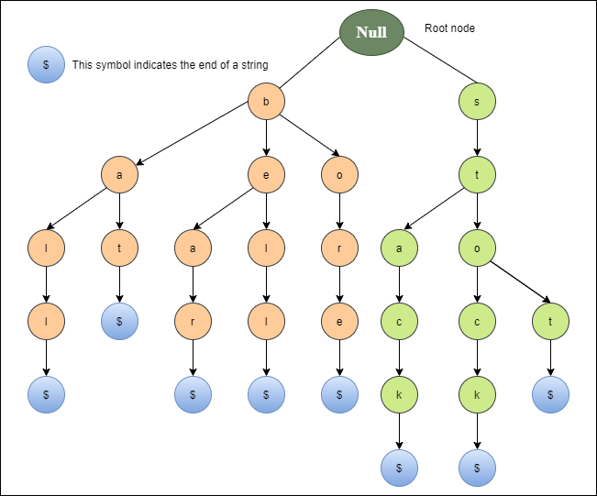
Properties of the Tries for a set of the string:
A trie representation for the words: ball, bat, bear, bell, bore, stack, stock and stop.
p

Slide 4
Tries
Every node of Trie consists of multiple branches. Each branch represents a possible character of keys.
We need to mark the last node of every key as end of word node. A Trie node field isEndOfWord is used to distinguish the node as end of word node.

Slide 5
Applications of Tries
1. Spell Checker
Spell checking is a three-step process.
First, look for that word in a dictionary,
generate possible suggestions, and
then sort the suggestion words with the desired word at the top.

Slide 6
Applications of Trie
1. Spell Checker
Trie is used to store the word in dictionaries.
The spell checker can easily be applied in the most efficient way by searching for words on a data structure.
Using trie not only makes it easy to see the word in the dictionary, but it is also simple to build an algorithm to include a collection of relevant words or suggestions.

Slide 7
Applications of Tries
2. Auto-complete
Auto-complete functionality is widely used on text editors, mobile applications, and the Internet.
It provides a simple way to find an alternative word to complete the word for the following reasons.
It provides an alphabetical filter of entries by the key of the node.
We trace pointers only to get the node that represents the string entered by the user.
As soon as you start typing, it tries to complete your input.

Slide 8
Applications of Tries
3. Browser history
It is also used to complete the URL in the browser.
The browser keeps a history of the URLs of the websites you've visited.

Slide 9
Advantage of Tries
With Trie, we can insert and find strings in O(L) time where L represent the length of a single word.
This is obviously faster than BST.
This is also faster than Hashing because of the ways it is implemented. We do not need to compute any hash function. No collision handling is required (like we do in open addressing and separate chaining)
Another advantage of Trie is, we can easily print all words in alphabetical order which is not easily possible with hashing.
We can efficiently do prefix search (or auto-complete) with Trie.

Slide 10
Drawbacks of Tries
Space Complexity:
Tries can be memory-intensive, especially for large datasets.
Overhead:
There can be additional overhead due to the pointers and links in the structure.

Slide 11
Suffix trees
Suffixes are one or more letters added to the end of a base word to change its conjugation, word type, or other grammar properties like plurality.
Eg-
you can add the suffix -s to the noun strength to make it plural (strengths) or
add the suffix –en to turn it into a verb (strengthen)
adding –ment to the verb pay to make the noun payment.

Slide 12
Suffix Tree
A Suffix Tree for a given text is a compressed trie for all suffixes of the given text.

Slide 13
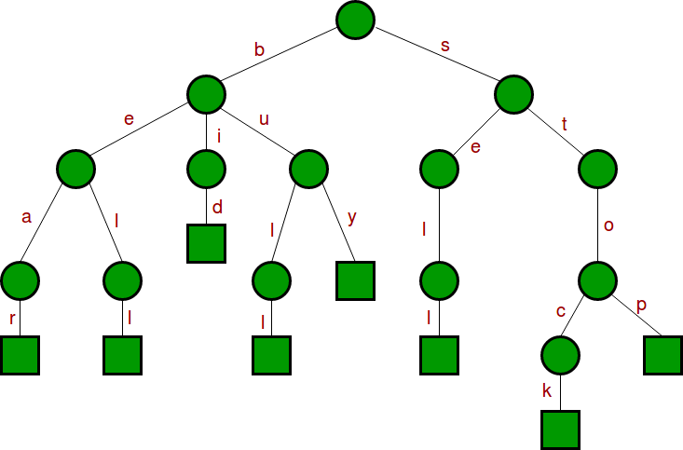
Trie
{bear, bell, bid, bull, buy, sell, stock, stop}
Following is standard trie for the above input set of words.

Slide 14
Suffix Tree
Suffix Tree-Compress Trie is obtained from standard trie by joining chains of single nodes. The nodes of a compressed trie can be stored by storing index ranges at the nodes.

Slide 15
Merits of Suffix Trees
Efficient Pattern Matching:
Suffix trees allow for fast pattern matching within a string.
Finding a substring takes O(m)) time, where m is the length of the substring, regardless of the length of the main string n.
Multiple Pattern Matching:
Useful in applications like bioinformatics, where they help in identifying occurrences of multiple patterns within the same sequence.
Linear Construction Time:
can be built in O(n)time, making them efficient for long strings.
Space Efficiency for Compressed Suffix Trees:
Compressed or succinct representations can reduce the space complexity, making them more practical for real-world usage.
Applications in Longest Common Substring Problems:
widely used in finding the longest common substring, repeated substrings, and similar operations efficiently.
Fast Lexicographical (dictionary) Sorting:
enables efficient sorting and lexicographical ordering of suffixes in a string.

Slide 16
Demerits of Suffix Trees
High Memory Usage:
Suffix trees require significant memory due to the number of nodes and edges, especially for large texts.
Complexity of Implementation:
Constructing and maintaining suffix trees can be complex, requiring careful implementation, particularly for handling edge cases and large datasets.
Limited Use Cases:
While powerful, suffix trees are not universally applicable.
They are ideal for certain string-processing tasks but may be overkill for simpler problems.
Longer Query Time for Non-Exact Matches:
Suffix trees are optimized for exact match queries.
Non-exact matching, such as approximate string matching, can be more challenging and inefficient with suffix trees.
Practical Limitations in Modern Applications:
For very large datasets, alternative data structures like suffix arrays and Burrows-Wheeler transform-based methods are sometimes preferred due to better space efficiency.

Slide 17
Pros and Cons of AVL Trees
Arguments for AVL trees:
All operations logarithmic worst-case because trees are always balanced
Height balancing adds no more than a constant factor to the speed of insert and delete
Arguments against AVL trees:
Difficult to program & debug [but done once in a library!]
More space for height field
Asymptotically faster but rebalancing takes a little time
If amortized logarithmic time is enough, use splay trees (also in the text, not covered in this class)

Slide 18
Advantages of Threaded Binary Trees
Faster Traversal: Enables non-recursive traversal, avoiding stack management, making it faster than unthreaded binary trees.
Efficient Navigation: Easily find predecessor and successor nodes without stacks, thanks to threads pointing upward.
Flexible Access: Any node can be accessed from any other node, enabling bidirectional movement with circular links.
Disadvantages of Threaded Binary Trees
Slow Modifications: Insertion and deletion are slower compared to unthreaded trees.
Extra Memory: Requires additional bits to identify threaded links.

Slide 19
DFS
Choose a starting node, mark it visited ,traverse it Push it into the stack
Rule 1 : If possible, visit an adjacent unvisited vertex, mark it visited, traverse it and push it on the stack.
Rule 2 : If Rule 1 fails, then pop a vertex off the stack follow Rule 1 from it.i.e. For the Vertex on the top of the stack, If there is no unvisited adjacent node only then we pop it.
Rule 3 : Repeat Rule 1 and Rule 2 until the all the vertices are visited.
BFS
Choose the start node, mark it visited, traverse it, enqueue it
Rule 1 : Visit all the next unvisited vertices (if any) that is adjacent to the current vertex(At Front end), and insert them into a queue one at a time on every visit.
Rule 2 : If there is no unvisited vertex, remove a vertex from the Queue and make it the current vertex and then follow Rule 1.
Rule 3 : Repeat Rule 1 and Rule 2 until the all the vertices visited.

Slide 20
